Slide 1
Parallel Preconditioner
SPAI Algorithm
YingZhang’s work
Speaker: Ying Zhang Jan 5, 2024

Slide 2
Teamwork/Mywork
At the project's outset, Chen was assigned the first three issues, Guo took on the fourth, and I handled the fifth. In the initial weeks, Guo opted to focus on exams, while Chen proposed a new idea just days before the project deadline. He wanted to explore the fifth issue independently, so I am now solely responsible for it. My project builds upon the framework Chen established, and I have incorporated his work into mine. Despite our divergent paths, I continue to integrate his contributions into my focused work on the fifth issue.
I'm currently working on the m5 branch of the project. Here's the link to the README file: https://github.com/AMSC22-23/matvetcg-chen-zhang-guo/blob/m5/README.md where you can find detailed information about my contributions.

Slide 3
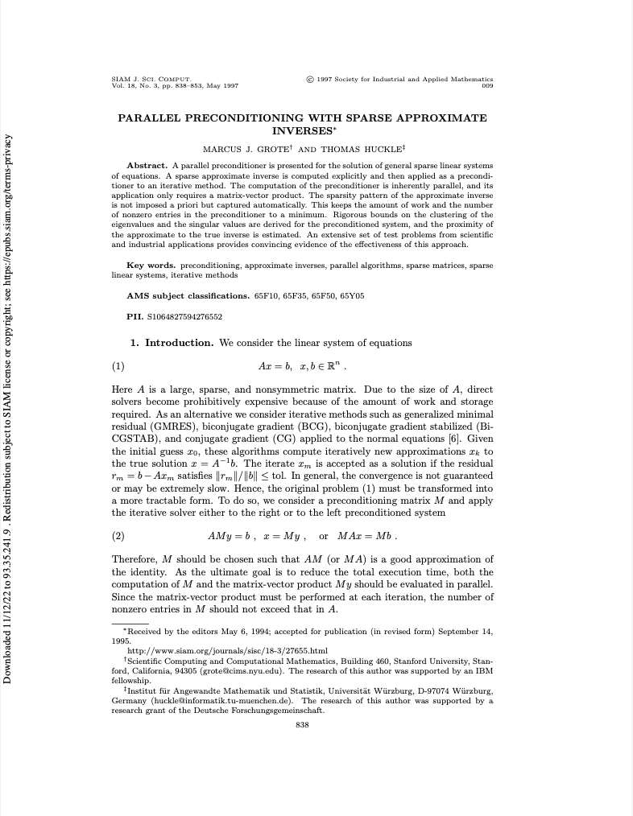
Implement a parallel preconditioner based on approximate inverse
ApproximateInversePreconditioner.pdf describes the SParse Approximate Inverse(SPAI) algorithm.
The SPAI algorithm computes a sparse approximate inverse $M$ of a general sparse matrix $A$. It is inherently parallel, since the columns of M are calculated independently of one another.

Slide 4
Idea
Consider the linear system of equations:
$$Ax=b,x,b∈R^{n}$$
Here $A$ is a large, sparse and nonsymmetric matrix.
This paper considers a preconditioning matrix M and apply the iterative solver either to the right or to the left preconditioned system
$AMy=b,x=My,orMAx=Mb.$

Slide 5
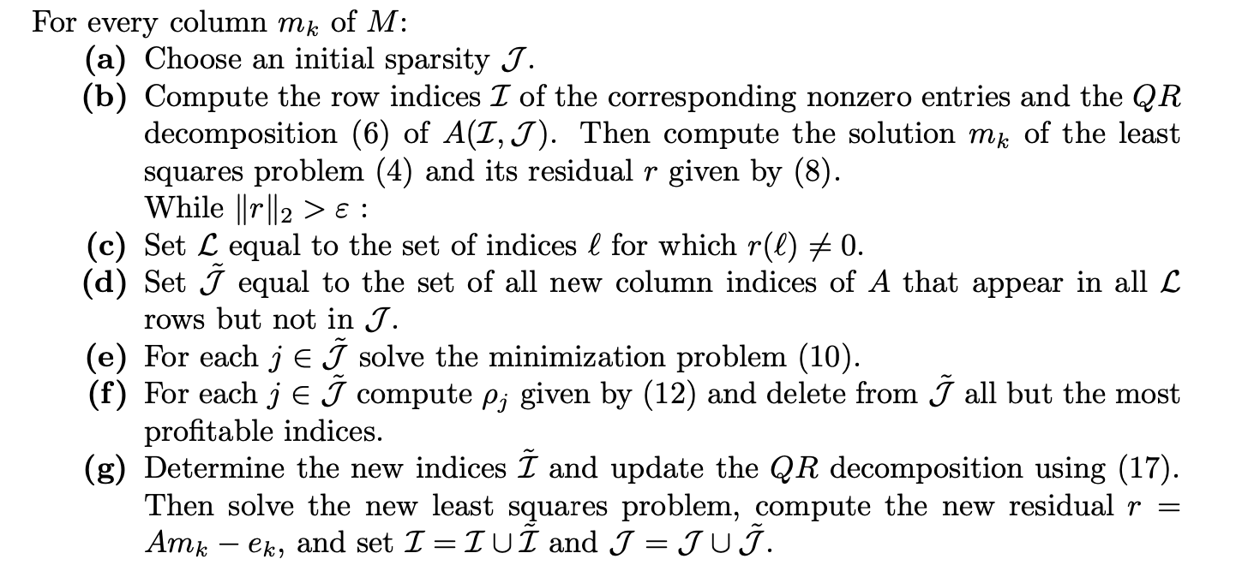
THE SPAI ALGORITHM

Slide 6
Implemented Versions of SPAI
In the folder /src/objective5
1. normal version without parallel - `spai.hpp` `test_spai.cpp`
2. openmp version parallelized by OpenMP based on normal version - `spai_openmp.hpp` `test_openmp.cpp`
3. mpi version parallelized by MPI based on normal version - `spai_mpi.hpp` `test_mpi.cpp`
4. use `MatrixWithVecSupport` class as the base matrix (comes from Mattteochen's work: https://github.com/AMSC22-23/matvetcg-chen-zhang-guo/blob/m5/src/shared/MatrixWithVecSupport.hpp ) based on normal version instead of sparse matrix of the Eigen library in the above work - `spai_mbase.hpp` `test_mbase.cpp`

Slide 7

Code Structure
Basically, for the application of the four SPAI algorithms, the process follows:
the test_*.cpp file reads one mtx file, stores it in matrix $A$, then calls the SPAI function in the corresponding spai_*.hpp file to obtain the sparse approximate inverse $M$. After that, both sides of the equation $Ax=b$ are multiplied by matrix $M$. Next, an iterative algorithm (CG and BiCGSTAB) is used to compute the equation.
*.mtx
test_*.cpp
spai_*.hpp

Slide 8
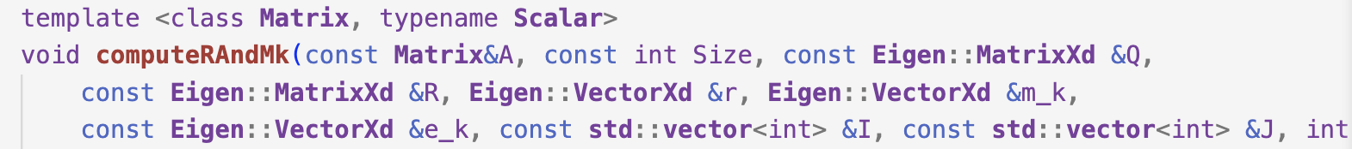
Code Structure
`spai.hpp`
Main process
Extract repeated work from the main process(Code contains detailed explanation.)

Slide 9


Code Structure
For normal version/openmp version/mpi version, matrix A and M is an instance of Eigen::SparseMatrix<double> class.
*.mtx
Matrix A: Eigen::SparseMatrix<double>
test_*.cpp
Matrix M: Eigen::SparseMatrix<double>
spai_*.hpp
Eigen CG and BiCGSTAB
(Code Optimisation: use smart pointers unique_ptr to enforce mandatory memory release for Eigen instances.)

Slide 10

Parallelization Strategy
For openmp version, we optimise the main process by OPENMP because SPAI is inherently parallel and the columns of M are calculated independently of one another.
`spai_openmp.hpp`

Slide 11
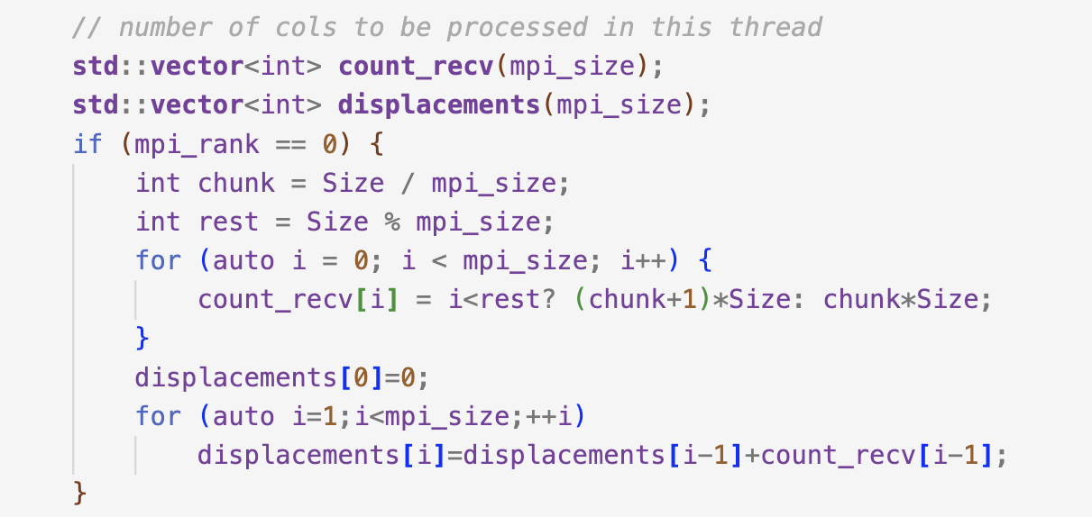
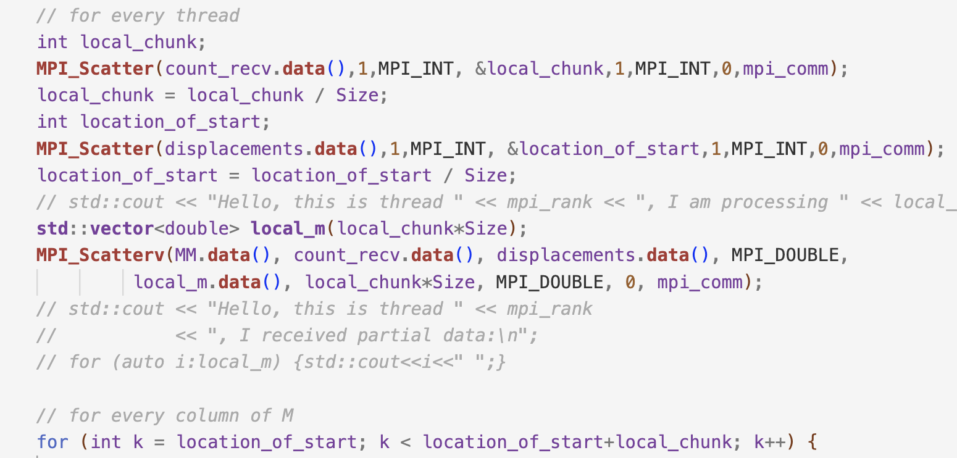
Parallelization Strategy
For mpi version, we optimise the main process by MPI.
At the beginning…

Slide 12
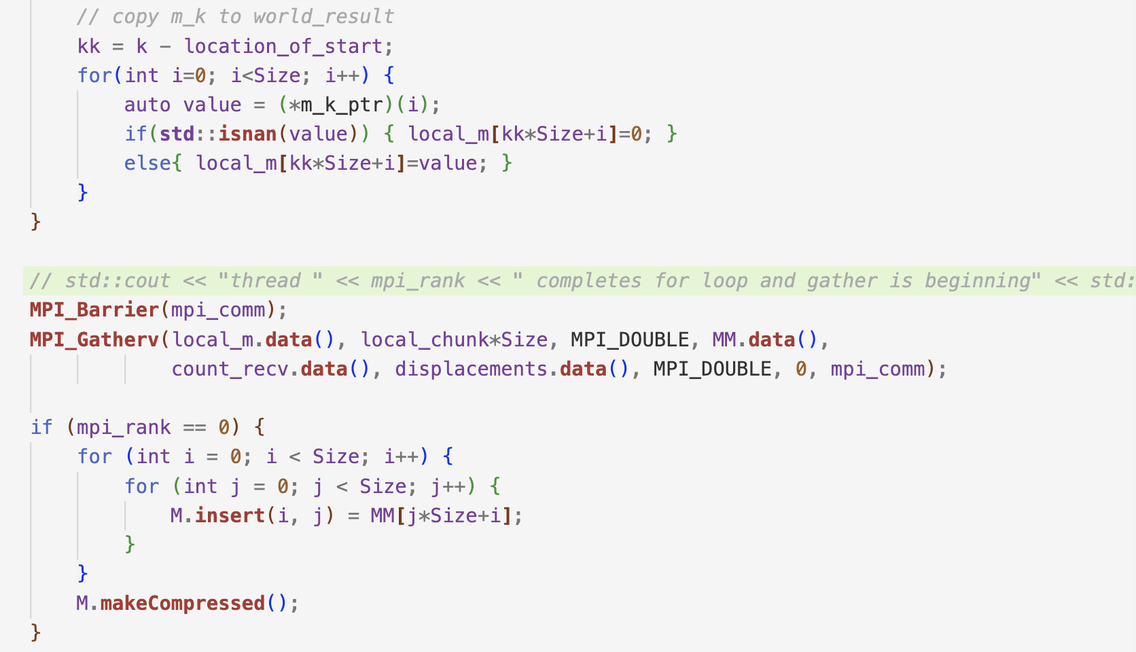
Parallelization Strategy
At the end…

Slide 13


Code Structure
For the fourth version, matrix A and M is an instance of MatrixWithVecSupport class.
*.mtx
Matrix A: MatrixWithVecSupport
test_*.cpp
Matrix M: MatrixWithVecSupport
spai_*.hpp
Adjusted hand-made CG and BiCGSTAB

Slide 14
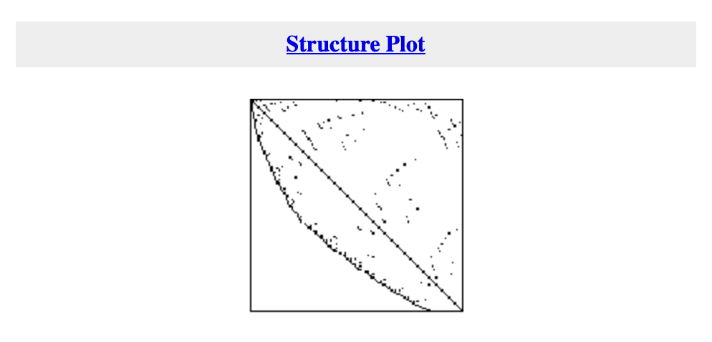
Numerical Experiment
Default setting: 4 threads for openmp and mpi threads setting
gre_115.mtx: n = 115 and nz = 421 entries

Slide 15
Initial Settings
For iterative solvers:
like Eigen CG/CG and Eigen BiCGSTAB/BiCGSTAB, the initial guess is a zero vector, the stopping criterion is 1e-8, the maximum iteration is 1000, b=A*e (e is a 1-vector).

Slide 16
Numerical Experiment
Convergence results: max_iter =10 , epsilon = 0.6
 | Spai | Spai with OpenMP | Spai with MPI | No preconditioner
Eigen CG/CG | >1000 | >1000 | >1000 | >1000
Eigen BiCGSTAB/BiCGSTAB | 21 | 21 | 21 | 698

Slide 17
Numerical Experiment
Execution time(microseconds) for getting M: max_iter =10 , epsilon = 0.6
 | Spai | Spai with OpenMP | Spai with MPI
 | 887813 | 800305 | 722501

Slide 18
Conclusion
1. The SPAI algorithm is very effective in improving the convergence of iterative solvers.
2. Parallelization strategies can decrease execution time.

